Slide 1
About Bangladesh
The Bengal tiger is the national animal of Bangladesh.

Slide 2
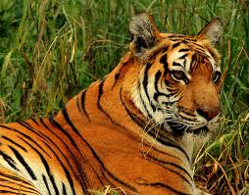
Panthera tigris tigris

Slide 3
By Jahid
Tigers in Bangladesh are now relegated to the forests of the Sundarbans and the Chittagong Hill Tracts.

